Slide 1
SOCIAL MEDIA ANALYTICS HOME WORK -1
BY Ravinthiran Partheepan

Slide 2
Query
Formulate a social media analytics task (what company would like to know) – e.g. clients opinion on the quality of the goods or services;
Find the media channel(s) you would like to observe
Select KPIs and social media metrics (general and channel specific)
Select a free tool for content data collection;
for behaviour data collection (structured/ unstructured data), user-entity; user-community, user-user;
For network structure data collection
Make a presentation and discuss

Slide 3
Technical Aspects
IDE Used Orange canvas 3 and R Script

Slide 4
Solution For the Query
First, I have Imported the Dataset which contains the data about Amazon Products Credentials(Buyers Info,URL,Reviews....)
Then I have Performed the Text Preprocessing.
With the Help of Sentiment analysis library, i have predicted neutral,Positive and Negative Values.
Then I have filtered out the used data using Data Sampler [Data sampling is a statistical analysis technique used to select, manipulate and analyze a representative subset of data points to identify patterns and trends in the larger data set being examined.
Then I have Visualized the Analysed data using Geo-Map Module.

Slide 5
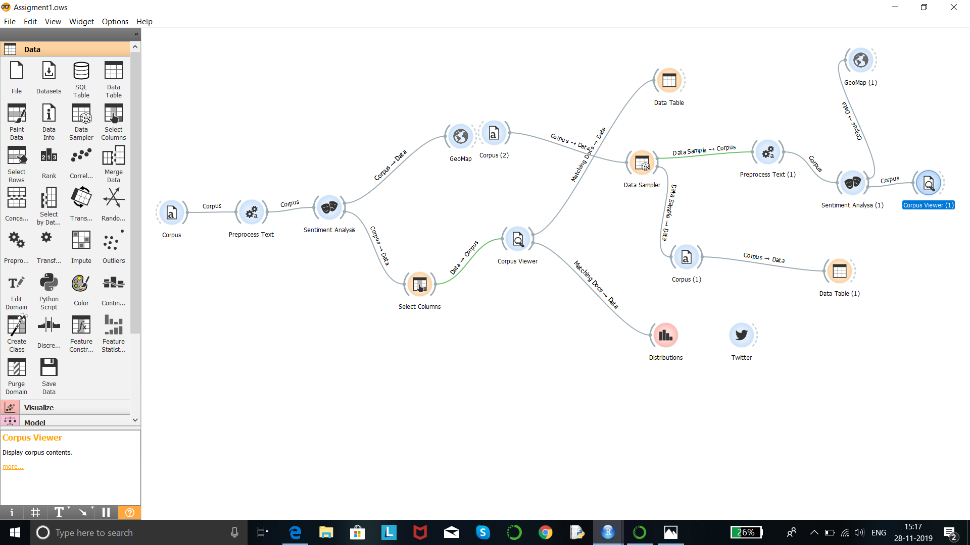
Program Code

Slide 6
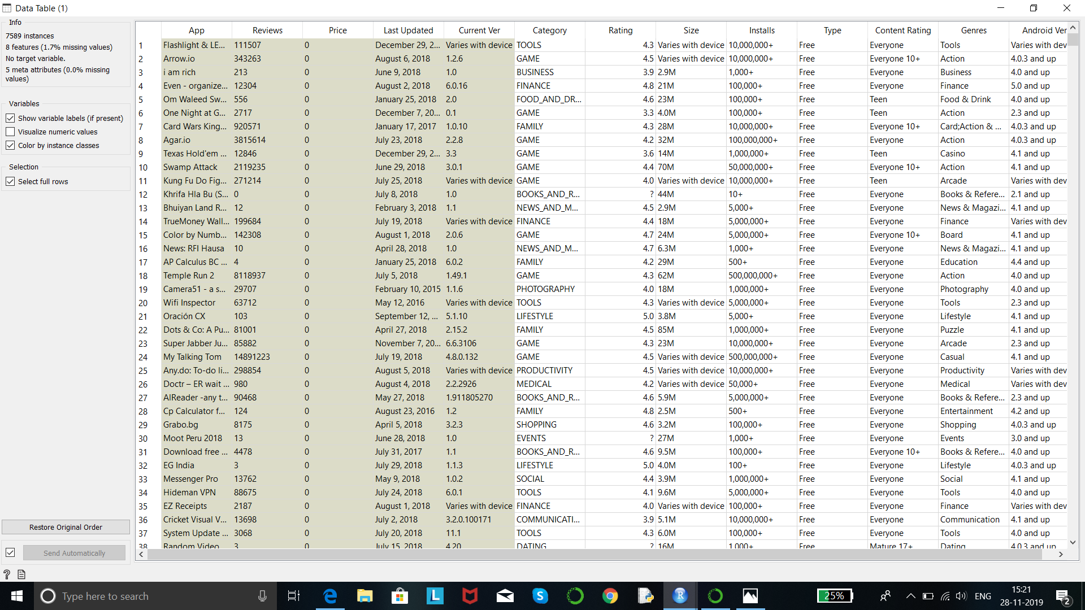
Dataset

Slide 7
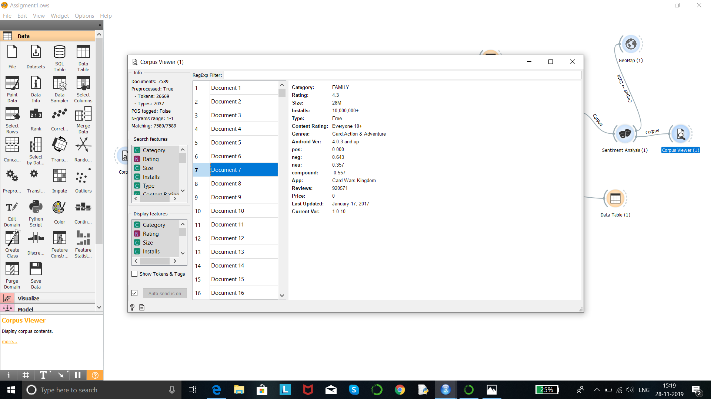
Output

Slide 8
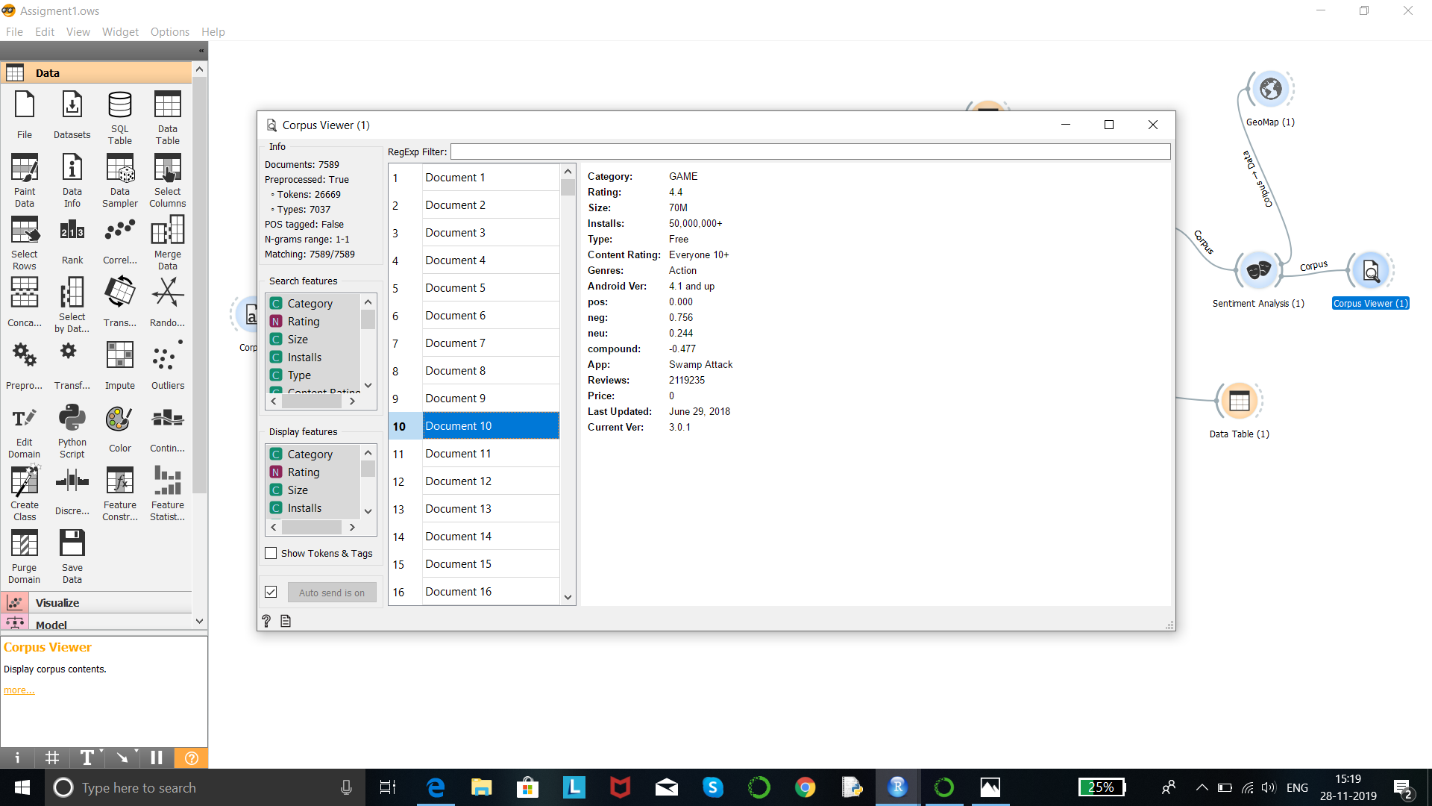
Output

Slide 9
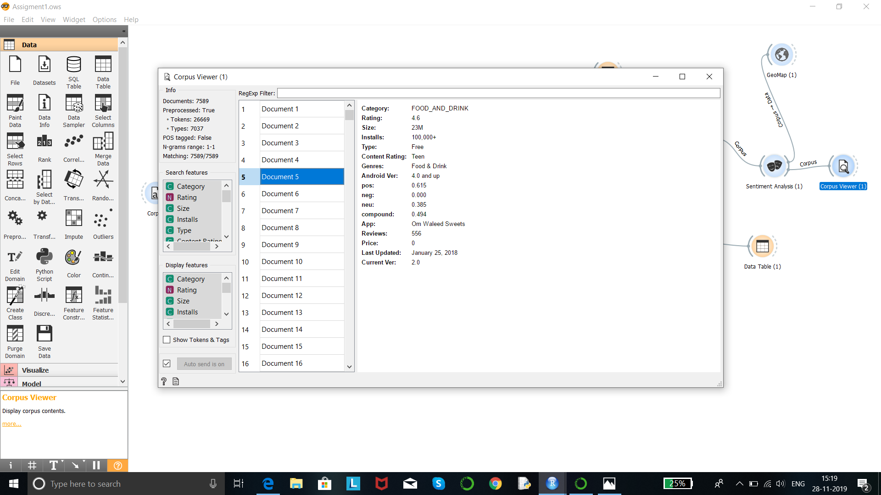
Output

Slide 10
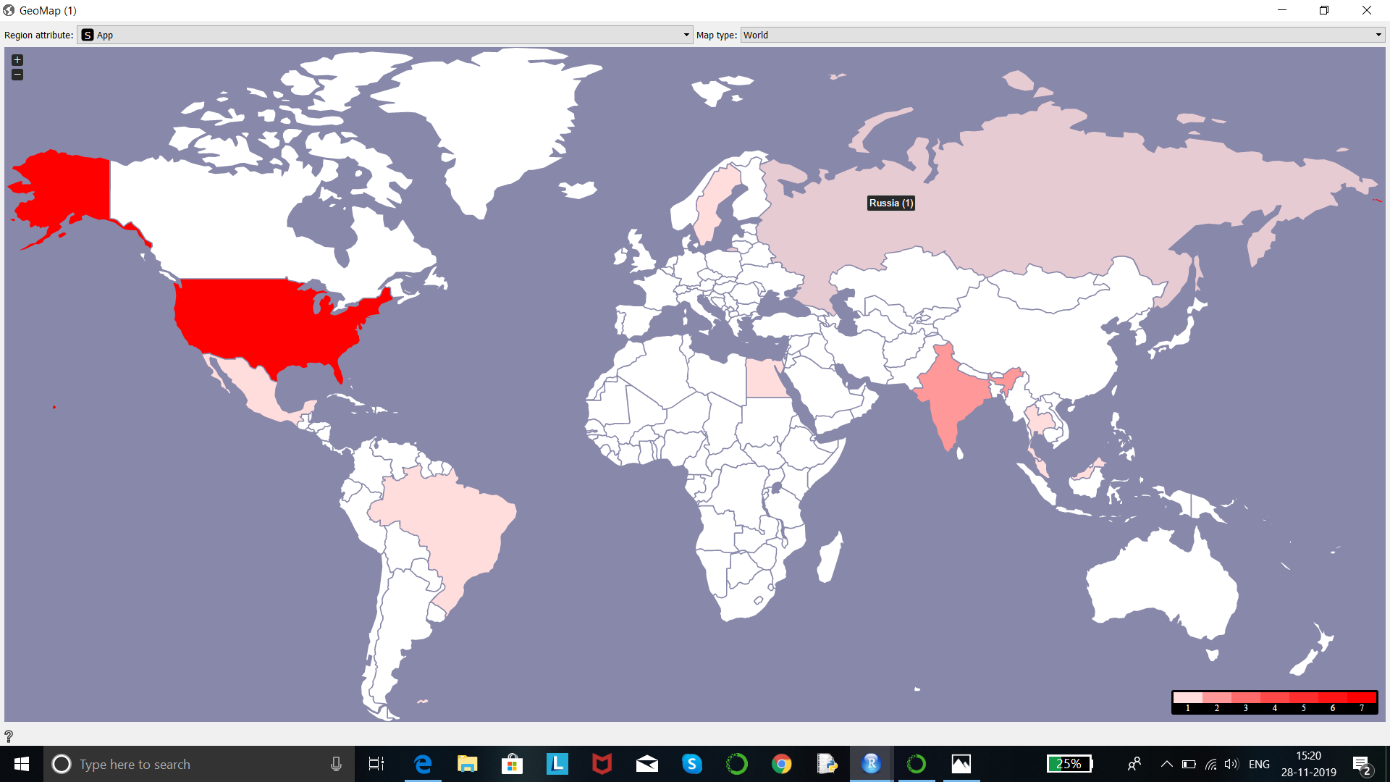
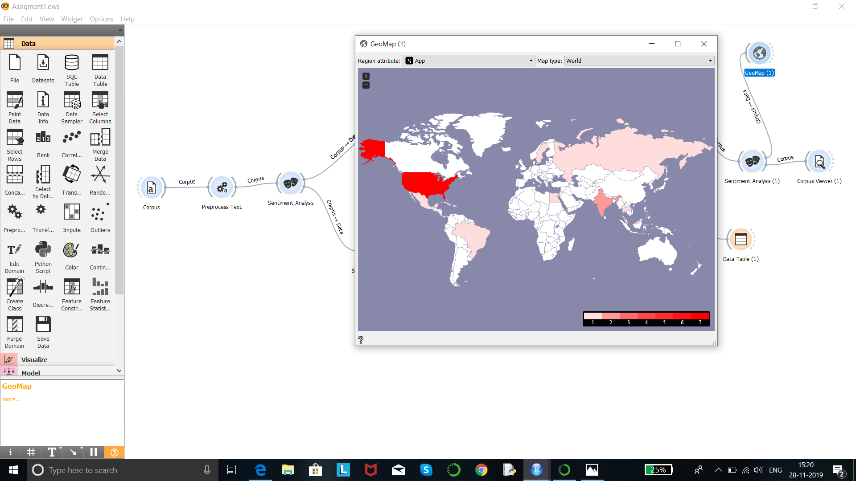
Output

Slide 11
Thank You!

